Slide 1
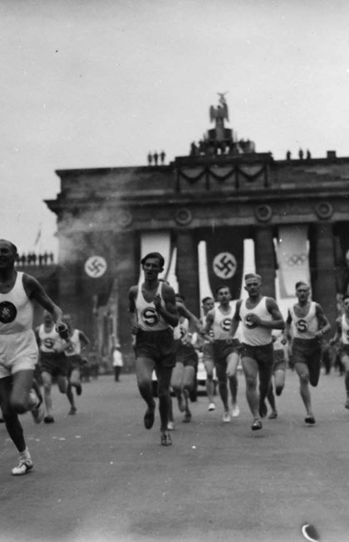
OLYMPIC Games vs WARS
Who Run THE WORLD ETL PROJECT

Slide 2






Team
Ana Davalos
Diana Chacon
Evgeniya Grigoreva
Frances Gliane
Mary Basco

Slide 3
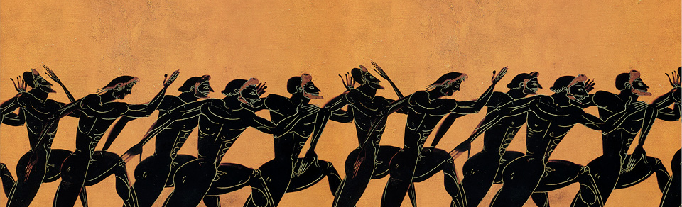
How many medals were won when a country was at war?
Who RUN THE WORLD. ETL PROJECT

Slide 4
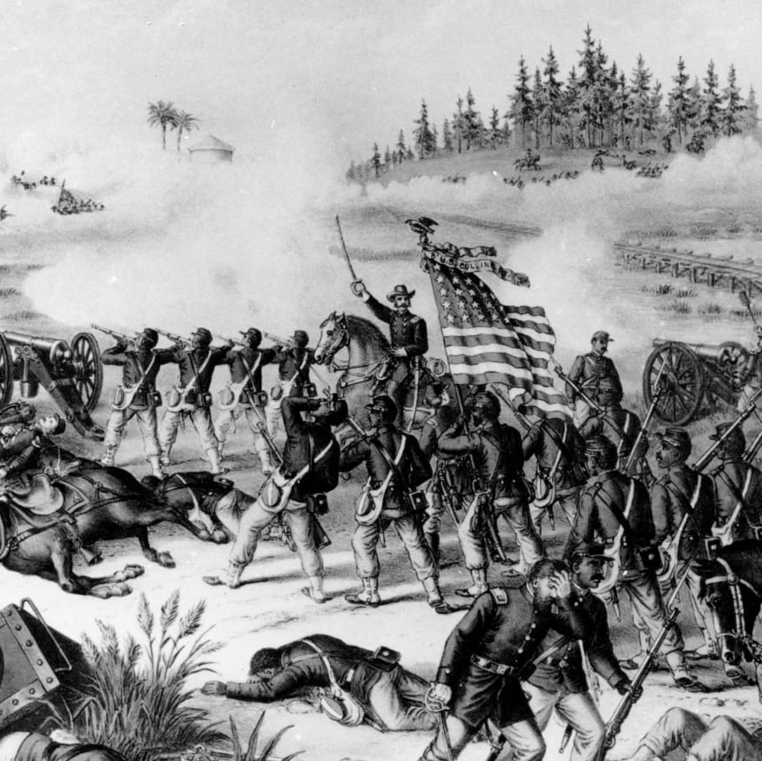
Finding Data
1. Olympic Sports and Medals, 1896-2014
How many medals were won when a country was at war?
https://www.kaggle.com/the-guardian/olympic-games
2. Correlates of War: Interstate Wars
Countries, dates, and fatalities of all wars between 1816 and 2007
https://www.kaggle.com/umichigan/interstate-wars
3. Google, Wikipedia for Country codes
Who RUN THE WORLD. ETL PROJECT

Slide 5
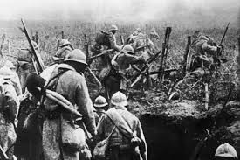
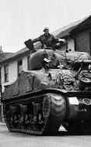
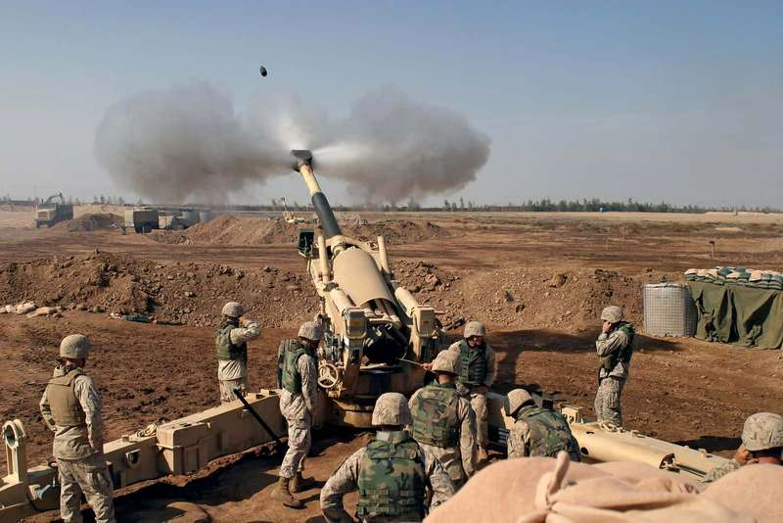
Data Cleanup & Analysis. WARS Part
Reading 3 CSVs: Extrawars, Intrawars, Interwars
Cleaning data
Concatenating data into one dataframe
Exporting to CSV
Who RUN THE WORLD. ETL PROJECT

Slide 6
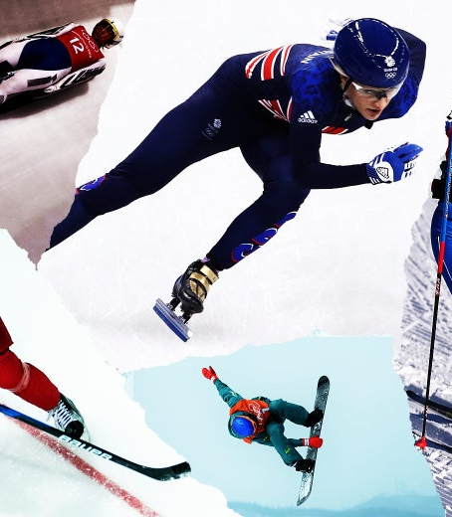
Data Cleanup & Analysis. OLYMPICS Part 1
Reading 3 CSVs: Winter games, Summer games, Dictionary
Concatenating Olympics data into one Dataframe in ascending order
Column names unification Country → Code, adding column Country
Grouping by year and finding out unique countries per this year
Exporting to CSV
Who RUN THE WORLD. ETL PROJECT

Slide 7
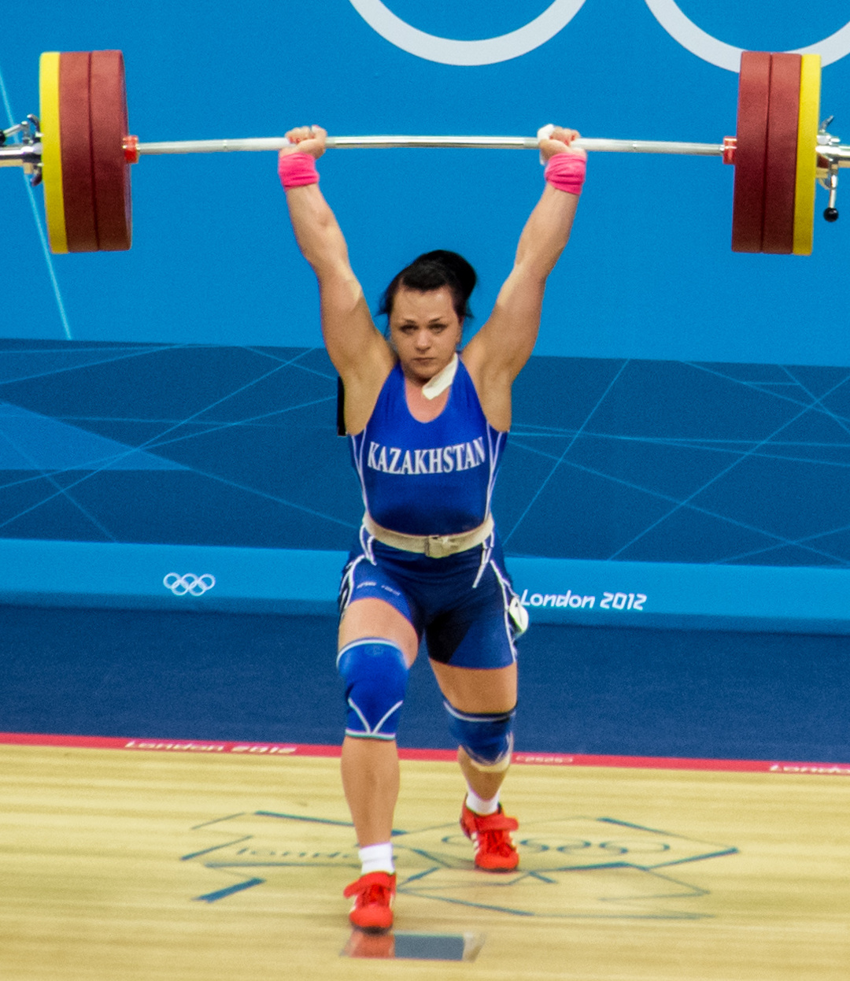
Data Cleanup & Analysis. OLYMPICS Part 2
DATA WAS INCONSISTENT!!!
Finding missing data and completing dictionary (raw CSVs)
Different codes for same country. I.e.: United States of America → EUA, USA, US etc.
Country names changes through the years. I.e. Russia → URS, UR1, RUS, OAR or Czech Republic → CZE, TCH etc.
Deleting records for unidentifiable codes
Exporting CSV into a database
Who RUN THE WORLD. ETL PROJECT

Slide 8



Loading to FINAL DATABASE
Relational Database Postgres (pgAdmin4)
Preparing data for loading into a relational database Postgres (pgAdmin 4)
Loading into a relational database Postgres (pgAdmin 4)
Aggregating data from two cleaned CSV:
Olympics data
Wars data
Tables:
Olympics
Wars
Who RUN THE WORLD. ETL PROJECT

Slide 9
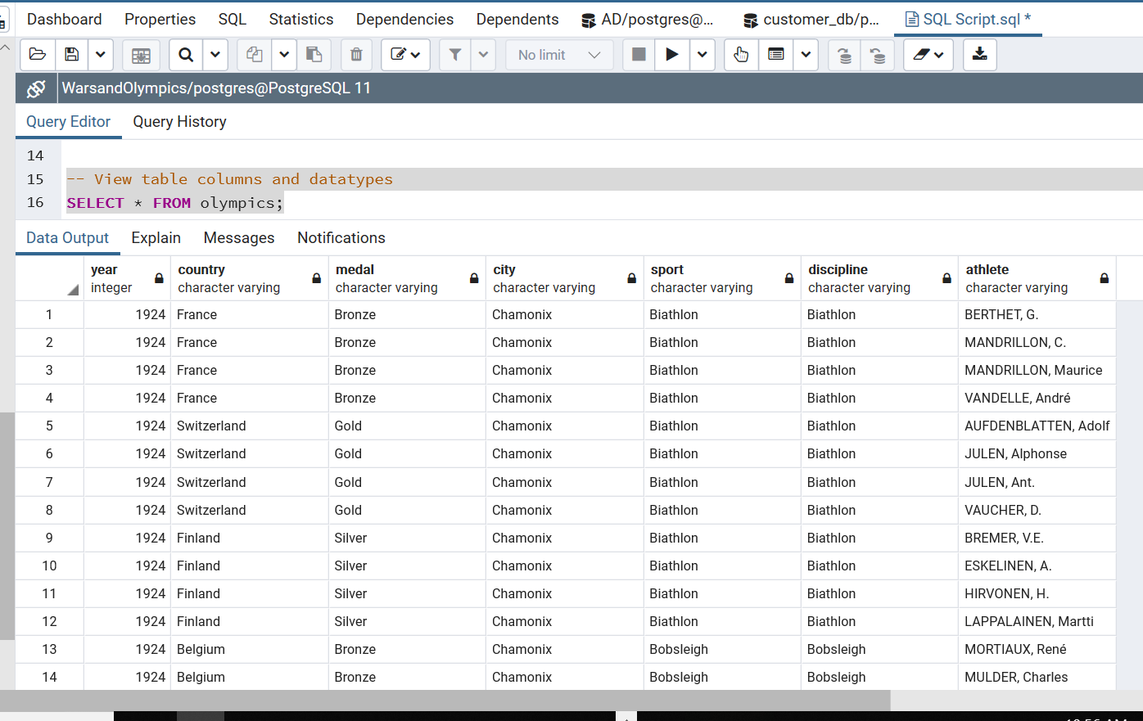
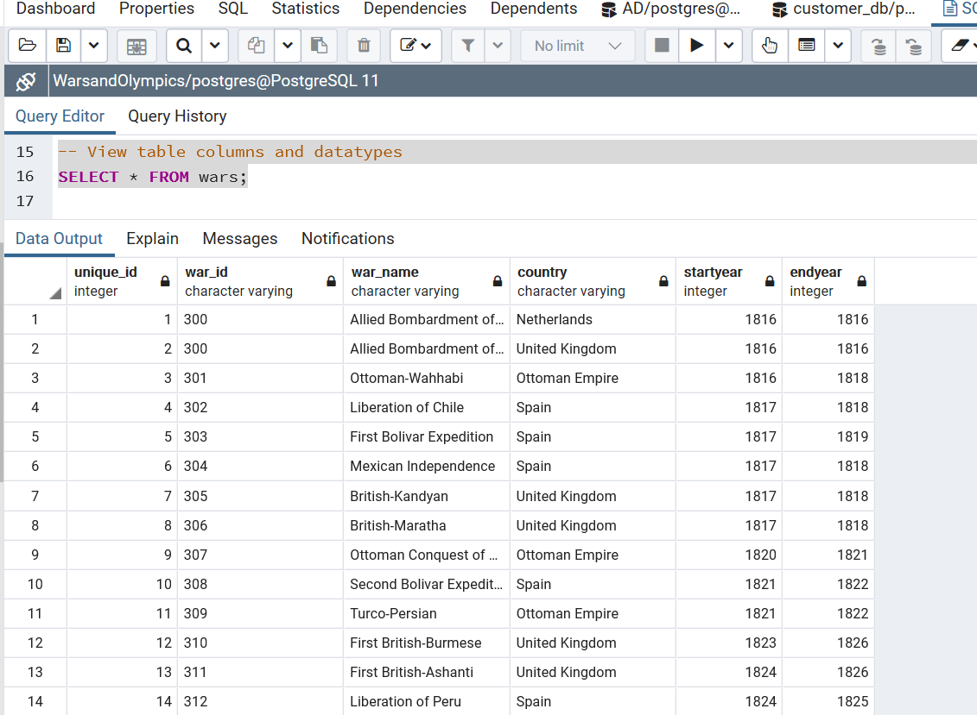
DATABASE Analysis. TABLES
Table WARS
Table OLYMPICS
WHO RUN THE WORLD. ETL PROJECT

Slide 10
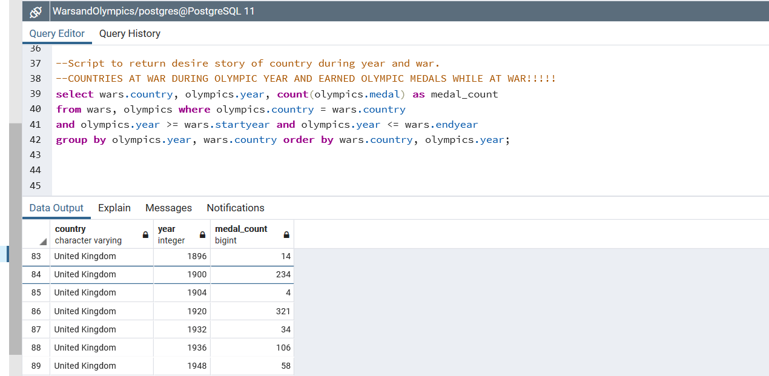
DATABASE Analysis. qUERIES
WHO RUN THE WORLD. ETL PROJECT

Slide 11
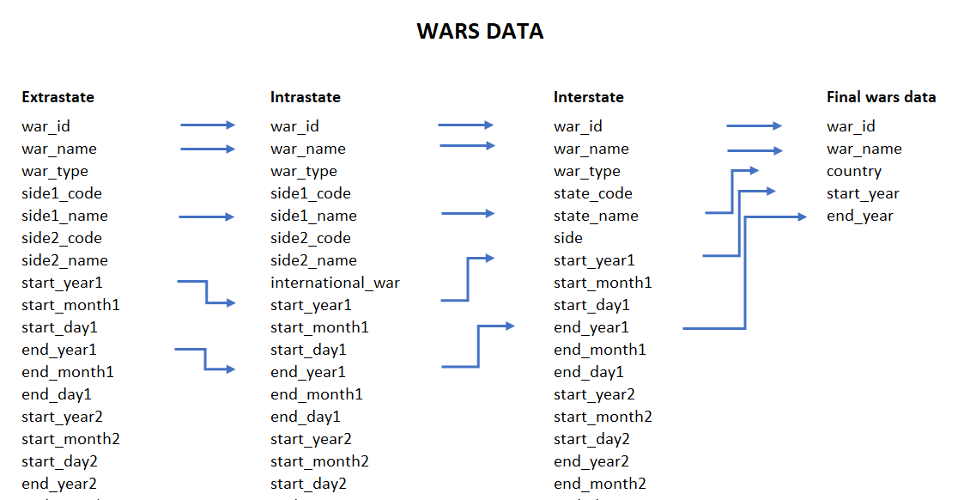
DATABASE Analysis. DATA MAPPING. WARS DATA
WHO RUN THE WORLD. ETL PROJECT

Slide 12
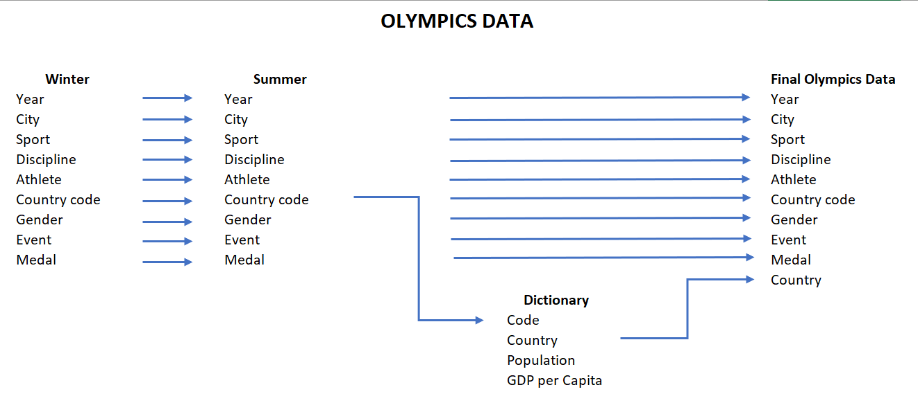
DATABASE Analysis. DATA MAPPING. OLYMPICS DATA
WHO RUN THE WORLD. ETL PROJECT

Slide 13
DATABASE Analysis. DATA MAPPING. OLYMPICS DATA
WHO RUN THE WORLD. ETL PROJECT

Slide 14
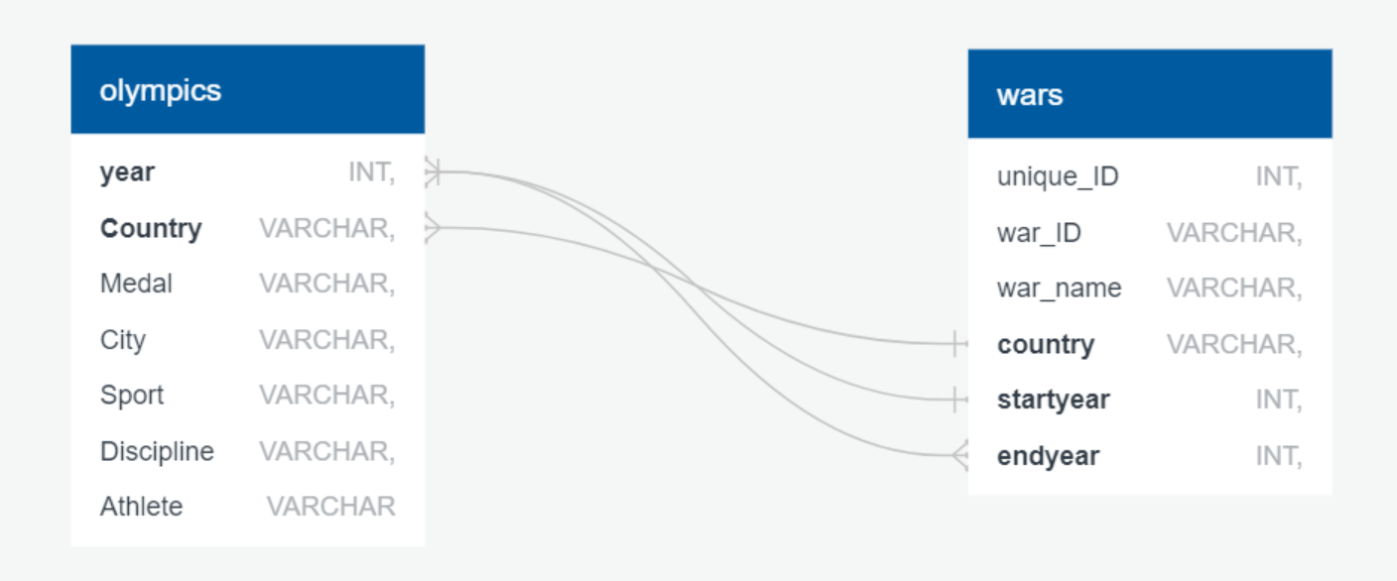
DATABASE Analysis. DATA MODeL
WHO RUN THE WORLD. ETL PROJECT

Slide 15
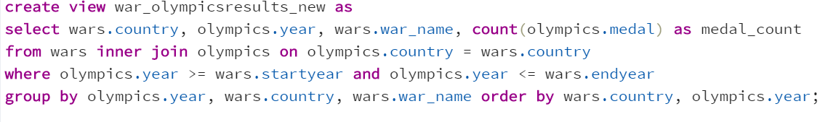
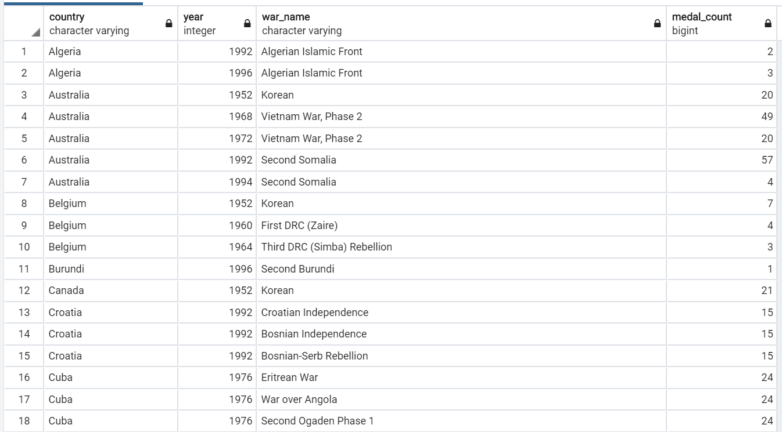
RESULTS
How many medals were won when a country was at war?

Slide 16
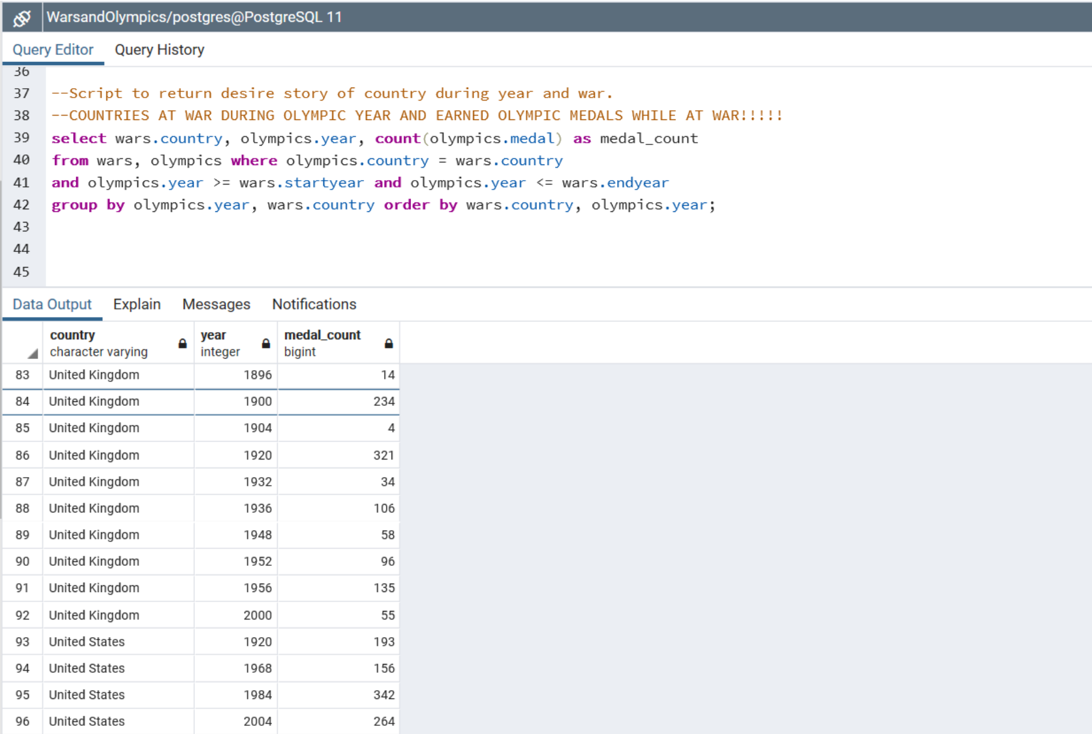
RESULTS
How many medals were won when a country was at war?

Slide 17
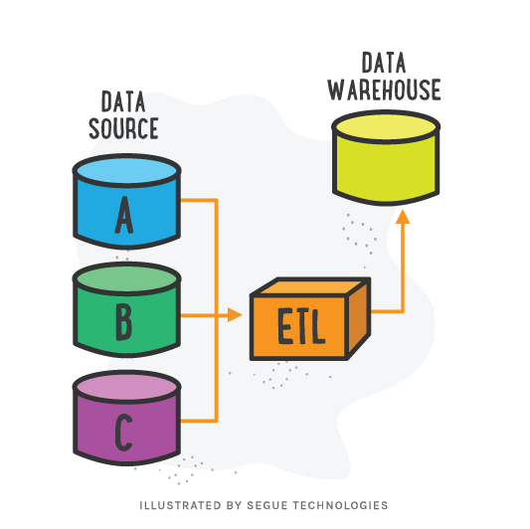
Conclusion
E
Excel is good for fast data check
T
Python can be used to clean, but
SQL is more efficient for transforming data
L = LOVE
DO SPORT, NOT WAR!
Who RUN THE WORLD. ETL PROJECT

Slide 18
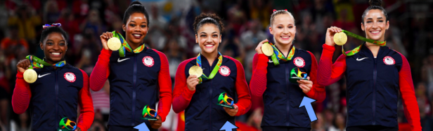
Questions?
Check our GITHUB repository for results
https://github.com/doccoteam/WhoRunTheWorld_ETL_Project
WHO RUN THE WORLD. ETL PROJECT

